Slide 1
Visual Design & Composition
Color
Learning from Others
Analyzing some websites
Notes:
Visual design helps with:
usability / readability / navigability
Delight your users
Communicates the values of your product and your brand

Slide 2
Announcements
Guest speaker (Victoria Chávez) on Wednesday to talk about accessibility
Lab 3 and Homework 1 will be posted this evening
How’d it go in Lab this week? Any questions?

Slide 3
Outline
Principles of composition
Color
Fonts and Typography
Branding

Slide 4
Outline
Principles of composition
Color
Fonts and Typography
Branding

Slide 5
Composition
Using proximity, alignment, contrast, asymmetry, color, and repetition to build hierarchy and enhance usability

Slide 6

Simple system, simple composition
Source: Ricky Holtz & Ellen Van Wyk
Notes:
Stop sign of systems- there is very little information, so they can have a simple composition that is pretty symmetrical. But they are not trying to communicate a lot of details to you, so it’s ok.
Hierarchy is built with text size, boldness.
What happens when you have no hierarchy and a complicated system?

Slide 7
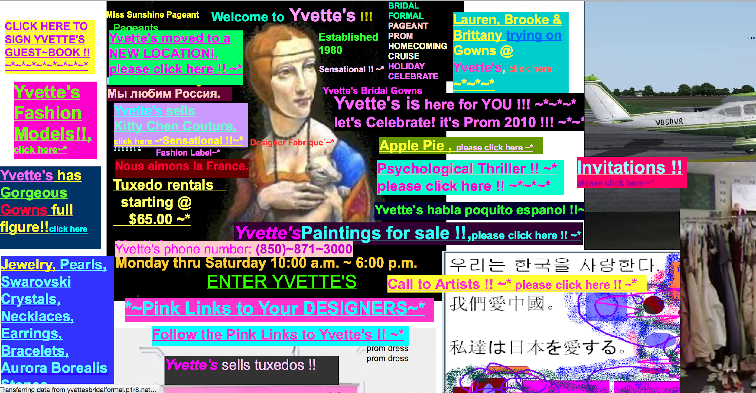
Complex system, simple composition
Source: Ricky Holtz & Ellen Van Wyk
Notes:
A lot of information. Where should you look first? No text is the most important based on color, size, bold,relationship to each other. Nothing stands out.
No chunking of information to simplify
Make sure you have white space

Slide 8

Complex system, complex composition
Notes:
Hierarchy. What do you want the user to see first? My search pattern is: and that’s intentional
Scanning patterns start at the top left. Where does the user’s eye go next? Image Title next, then the bold title on the lower left, then the right titles. (banner blindness!)
Type is guiding your eye before you even read it.
Whitespace. Build hierarchy, relationships, and helps to not overwhelm.

Slide 9





Building Hierarchy for complex systems
proximity / repetition
proximity / repetition
contrast (color)
contrast (size)
alignment / asymmetry
Source: Ricky Holtz & Ellen Van Wyk
Notes:
How can we build a hierarchy to structure information and guide people’s eyes?
Also, directing gaze, top left corner
All of these use white space
Use of symmetry- asymmetry makes us uncomfortable, draws attention to things.

Slide 10
4 Principles of Composition (of many)
Proximity
Alignment
Repetition
Contrast

Slide 11
Proximity

Slide 12
Principle of Proximity
Physical closeness implies a relationship.
Group related items together
Separate items that are not related
Notes:
How much scanning is your eye doing?
What things are related?

Slide 13
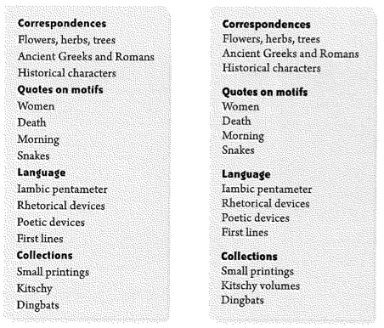
Which is easier to scan and interpret?
Notes:
What’s wrong with this example?
The bold headings suggest that there’s a grouping
But there’s the same amount of space between each line – no visual groups created
This one is much better – more space between groups, visually separated

Slide 14
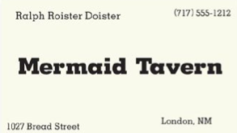
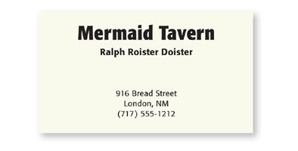
Which is easier to scan and interpret?
Notes:
What’s wrong with this example?
The bold headings suggest that there’s a grouping
But there’s the same amount of space between each line – no visual groups created
This one is much better – more space between groups, visually separated

Slide 15
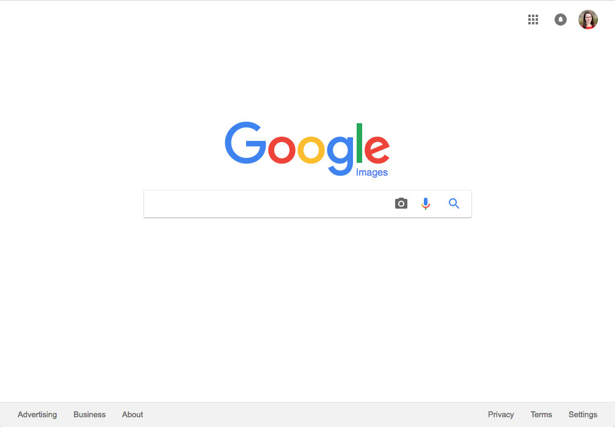
What is the purpose of all this whitespace?
Notes:
Google’s homepage is one of the best examples of effective white space use.
Most important features are in the center – the search bar and options
Profile-related controls are grouped in the upper right
Informational controls at the bottom left
Settings at the bottom right
Your eye very quickly identifies the controls, understands how they’re related

Slide 16
Use Whitespace
Helps to group items
Helps readers scan
Suggestions:
Put margins (white space) around all content.
Maintain a sense of proportion between the object and its surroundings.
Don’t crowd controls together (even if grouped).
Notes:
One of the common mistakes of new designers is to want to fill all the space up.
One of the most effective ways of conveying groupings is through white space
Empty space can help readers scan, help differentiate between groups
To use white space effectively:
Put margins around all content.
Maintain a sense of proportions between the object and its surroundings
Don’t crowd controls together (even if they’re grouped).

Slide 17
Alignment

Slide 18
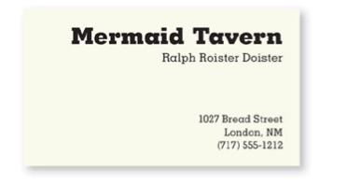
Principle of Alignment
Nothing should be placed arbitrarily.
Every item should have a visual connection with something else on the page.
Notes:
Principle of alignment – nothing should be placed arbitrarily
Every item should have a visual connection with something else on the page
When items are aligned, the reader perceives a stronger cohesive unit
Look at this business card again
No clear alignment – text is centered, left-aligned, right-aligned
Baselines for text aren’t alighted – London, NM is higher
Re-designed version
This is better, because the proximity is fixed, but center-aligned, doesn’t create strong lines
Third version
If we move the items all to the right – much stronger visual line

Slide 19
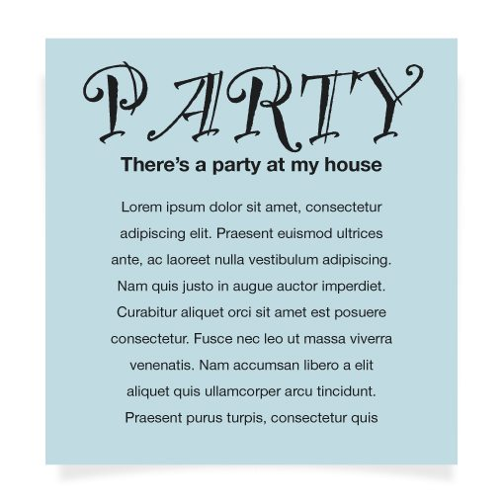
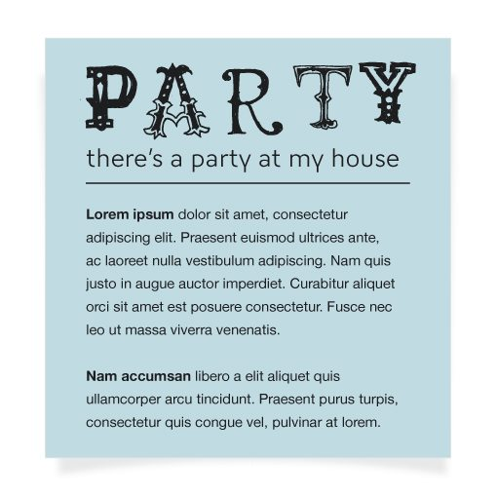
Avoid center-aligned text
Notes:
This may be counter-intuitive, but you really want to avoid center-aligned text in most cases
It’s familiar and feels safe, but it results in wimpy vertical lines.
This is especially true if you have a larger paragraph of text
Look at this party invitation
Pretty bland, even though it uses a fun font
Everything’s centered around the middle
Compare to this re-designed version
There’s better proximity in this design – different groupings
But there’s also a strong vertical line that makes it easy and satisfying to scan

Slide 20
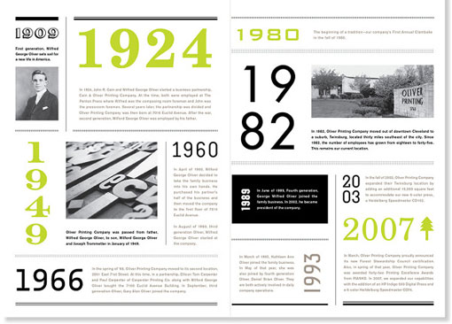
Notes:
Use grids — help your user know here to go next!

Slide 21
Alignment Summary
Main goal: unify and organize content
Be conscious of where you place items
Work within a grid
Avoid:
Using more than one text alignment
Use centered alignment consciously and for a purpose, not by default
Notes:
Main goal: unify and organize content.
Be conscious of where you place items.
Avoid:
Using more than one text alignment.
Use centered alignment consciously and for a purpose, not by default.

Slide 22
Repetition

Slide 23
Principle of Repetition
Repeat some aspect of the design throughout the entire piece.
Partially about consistency (Norman) but goes even further to unify the design.
Could be any aspect of the design (fonts, colors, design elements, proximity, alignment)
Notes:
Principle of repetition – repeat some aspect of the design throughout the entire piece.
We’ve already talked about one form of repetition, which is consistency (Norman Design Principle)
More than just being consistent in font and layout
Pushing consistency a little bit farther to really unify the design
Create a coherent visual experience
You can repeat any aspect of your design
A particular font.
Color(s)
Design element (icon, logo, etc.)
Visual alignment or spatial relationships.

Slide 24
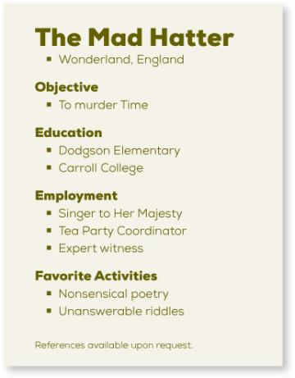
What is repeating?
Bold typeface
Light typeface
Square bullets
Indents
Spacing
Left alignment
Notes:
So let’s look at this simple text. What’s repeated here?
This is simple, but there are a ton of repetitions
Bold typeface
Light typeface
Square bullets
Indents
Spacing
Left alignment

Slide 25
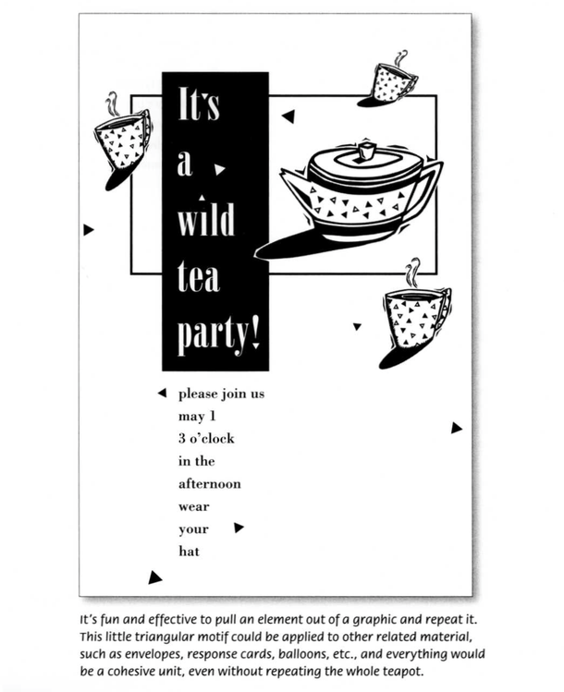
What is repeating?
Left alignment
Teacups
Triangles
Squares
(more about branding)
Notes:
Repetition doesn’t have to be just in the text!
Here we have a few different repetitions:
Left alignment
Teacups
Triangles
Squares
http://uiuxstuff.com/the-non-designers-design-book-summary-part1/

Slide 26
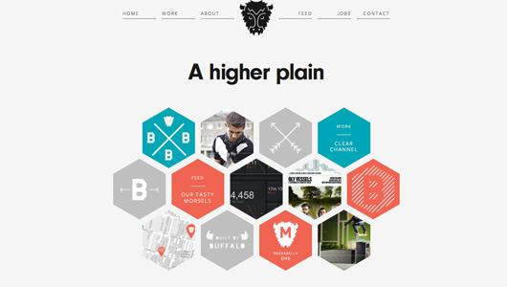
What is repeating?
Notes:
What about in this one?
This example has a beautiful use of proximity
Also an excellent example of repetition:
Hexagons
Colors
Cross symbol
B icon
Buffalo horns
Font

Slide 27
Repetition Summary
Main goal: unify and provide visual interest.
Create repetition by
Strengthening repetitions that already exist
Creating new ones to enhance the design
Avoid over-repetition (it’s annoying)
Notes:
Main goal: unify and provide visual interest.
Create repetition by:
Strengthening repetitions that already exist.
Creating new ones to enhance the design.
Avoid over-repetition (it’s annoying).

Slide 28
Contrast

Slide 29
Principle of Contrast
Contrast to draw a reader’s eye to certain parts of the page
Contrast can be created in many ways:
Size
Color (cool v. warm)
Whitespace
Asymmetry
Be bold!
For contrast to be effective, it must be strong
Notes:
Principle of contrast – contrast elements to draw a reader’s eye into the page
Adds visual interest, also creates an organizational hierarchy
You can create contrast in many ways with many different types of elements
Large type vs. small type
Graceful old-style font vs. bold sans serif
Cool color vs. warm color
Small graphic vs. large graphic
Main advice from Williams in the Non-Designer’s Design Book – don’t be a wimp!
For contrast to be effective, it must be strong and bold

Slide 30
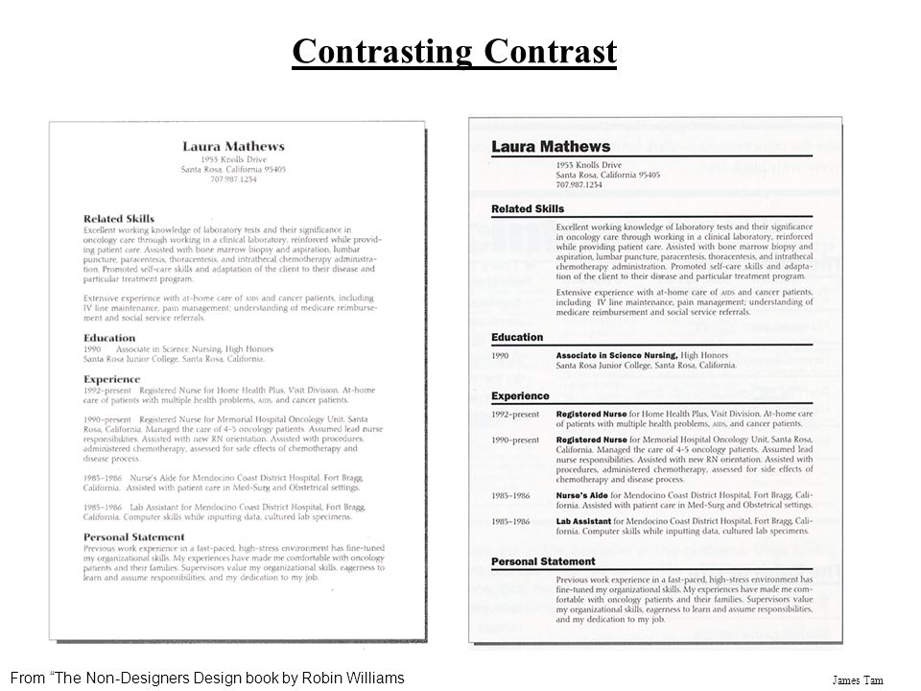
Whis is easier to scan?
Notes:
Contrast is important on resumes too! Take these ideas and apply them to your resumes
Look at this classic resume – what’s wrong with it?
Job tiles don’t stand out – blend with the body text
Sections aren’t very clearly defined
Space between accomplishments and the sections is the same
These are all easy to fix!
Look at this re-designed version
Clearly delineated sections
Alignment is clean, separates dates from text, strong vertical lines

Slide 31


Whis is easier to scan?
Notes:
Dog bakery flyer – what’s wrong here?
Alignment isn’t great – it’s all center-aligned so there isn’t any strong vertical line
There’s also no contrast – all the text looks the same, nothing stands out
Content is grouped, but there’s no clear visual separation between content types
Re-designed version
Bold, draws in your eye
Clear contrast with the title at the top
Repetition – black bar on the bottom, organizes contact information
Contrast between the different types of text
Contrast can make or break your design

Slide 32
Contrast Summary
Two main goals
Create visual interest
Effective information organization
Effective contrast is strong
Elements have to be styled very differently
Be bold!
Notes:
Two main goals:
Create visual interest on your page.
Make the organization of information clear.
Effective contrast is strong:
Elements have to be styled very differently.
Don’t be a wimp!

Slide 33
Activity

Slide 34
CSS & Layouts
Layouts are the hardest thing about CSS for many reasons:
The language has many, many different layout ‘paradigms’ for doing the same thing.
Specifying the rules for arranging boxes the right way is difficult
You have to design for several different browser configurations (what looks good on a desktop doesn’t necessarily look good on mobile).
Everything has to be flexible and resizable so that it scales gracefully.

Slide 35
Activity: Composing a Layout in CSS
Let’s deconstruct this template website:
How does this website instantiate the principles of:
Proximity (think whitespace)
Alignment (think grid)
Repetition
Contrast
Let’s draw some boxes...
Let’s think about how to create this layout. Some properties to highlight:
“position: fixed”
Margin and padding
Grid

Slide 36
Outline
Principles of composition
Color
Fonts and Typography
Branding

Slide 37
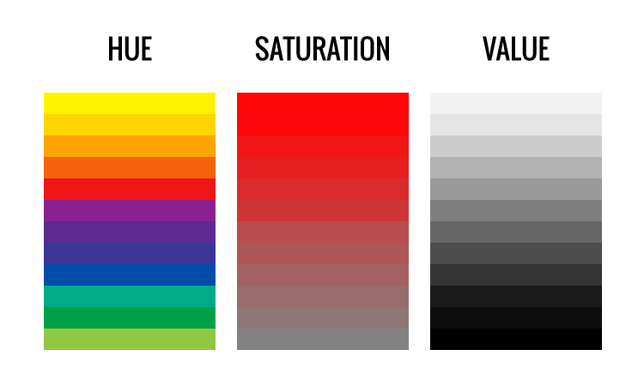
3 Dimensions of Color
Hue: The tint
Saturation: how intense the color is. When color is fully saturated, the color is considered in purest (truest) version
Value: lightness or darkness of a color
Source: Ricky Holtz & Ellen Van Wyk
Notes:
Hue: The tint
Saturation: how intense the color is. When color is fully saturated, the color is considered in purest (truest) version
Value: lightness or darkness of a color

Slide 38
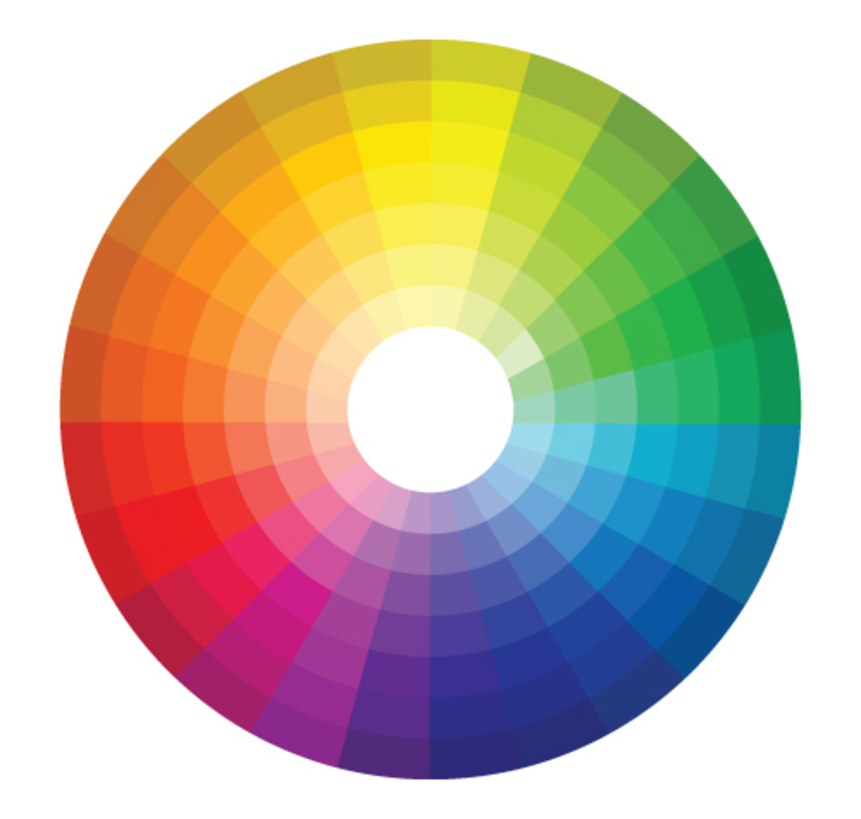
Notes:
Good to think about color palettes. I’m going to talk about some color schemes based on the wheel
Complementary

Slide 39
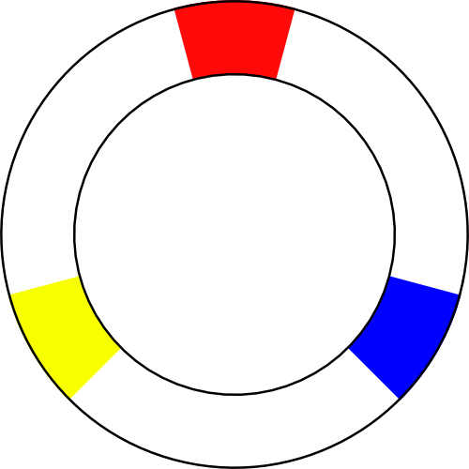
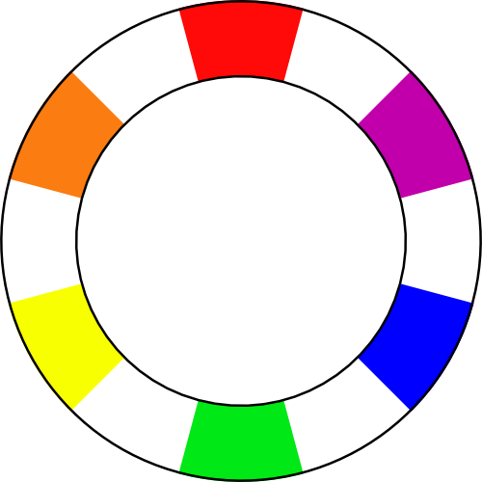
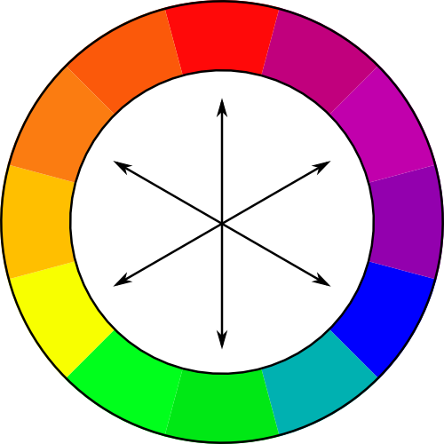
Primary
Secondary
Tertiary
Notes:
Good to think about color palettes. I’m going to talk about some color schemes based on the wheel
Complementary

Slide 40


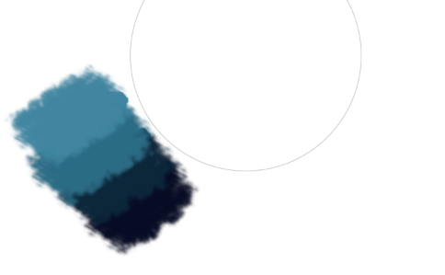
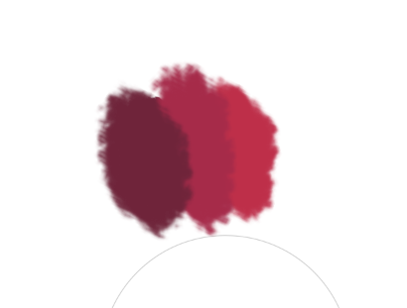
Monochromatic
Notes:
Monochromatic: same hue, but adding white or black or gray

Slide 41
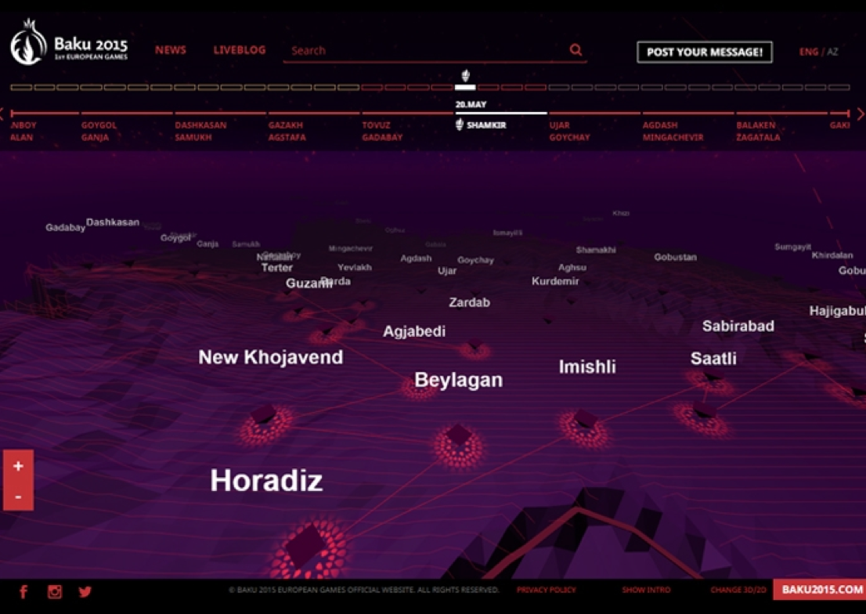

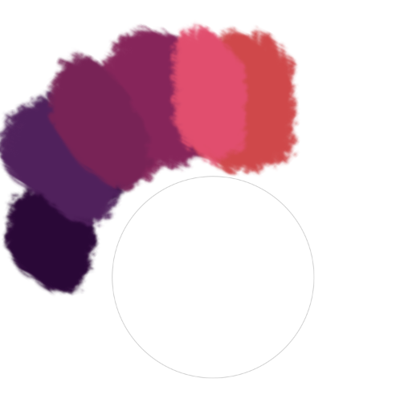
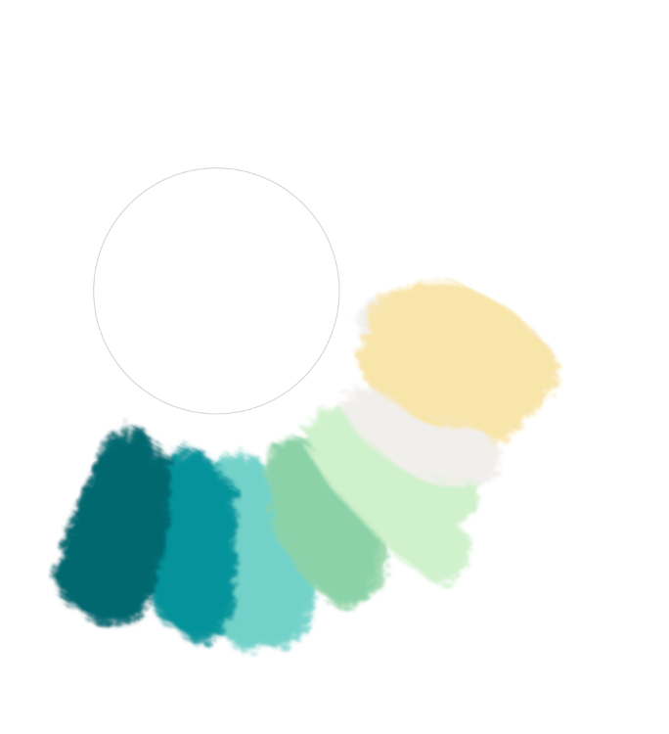
Analogous
Notes:
Analogous colors are those that are next to each other on the color wheel

Slide 42

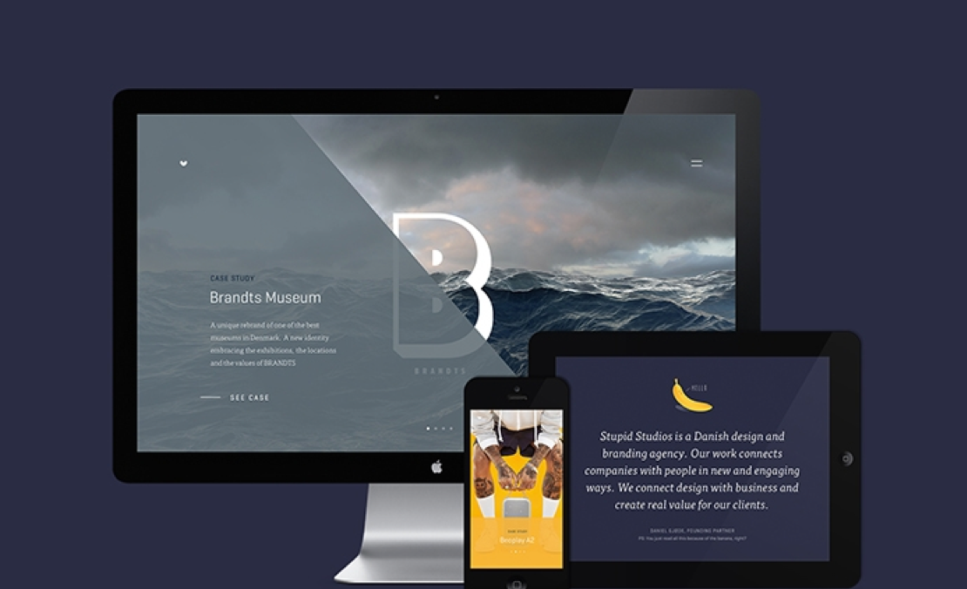
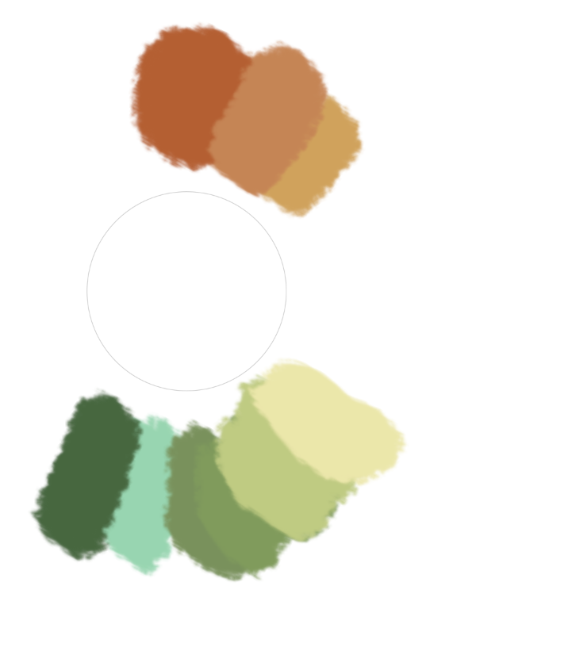
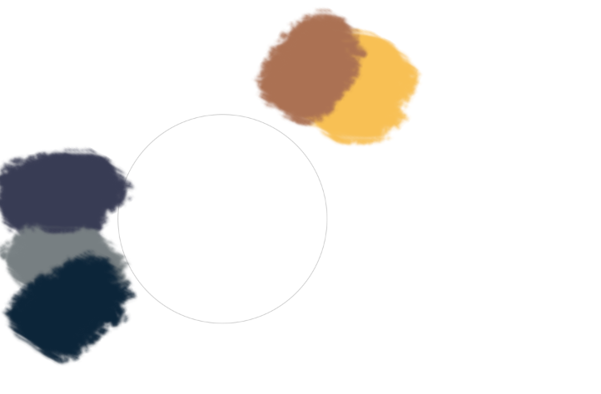
Complementary
Notes:
Colors on the opposite side of the color wheel (cool and warm colors).
Notice that the colors are desaturated
They tend to make each other pop

Slide 43

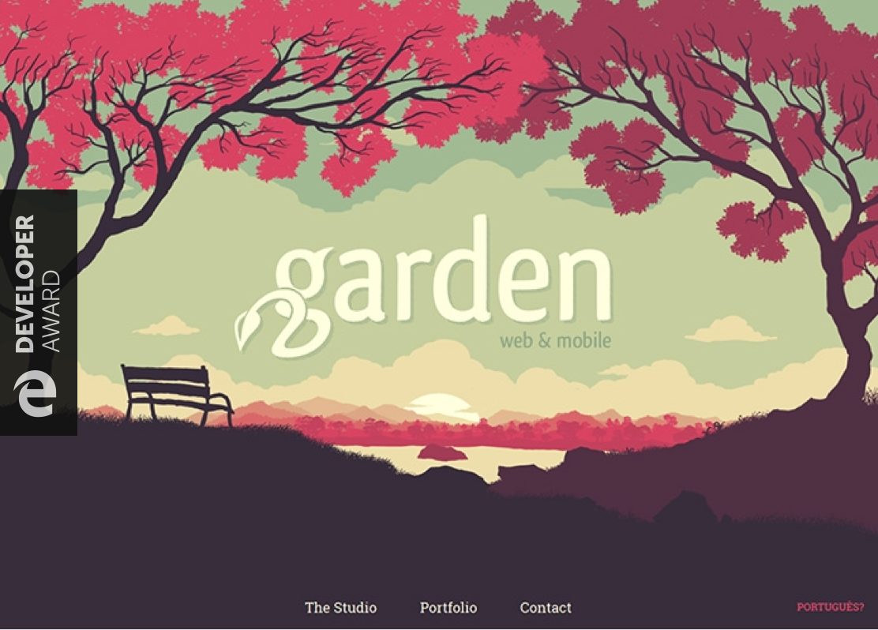
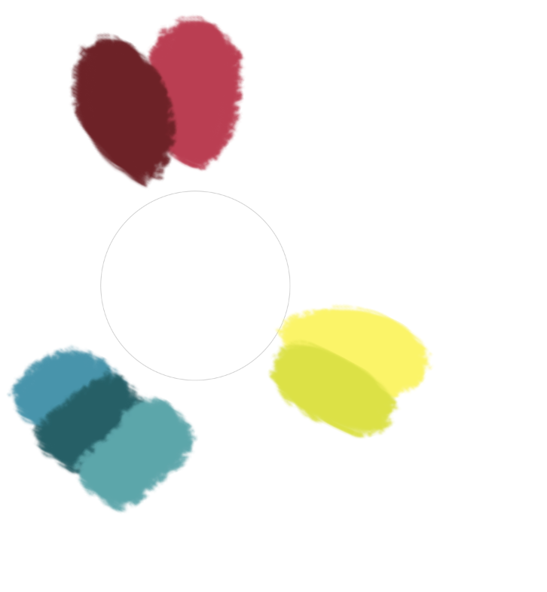
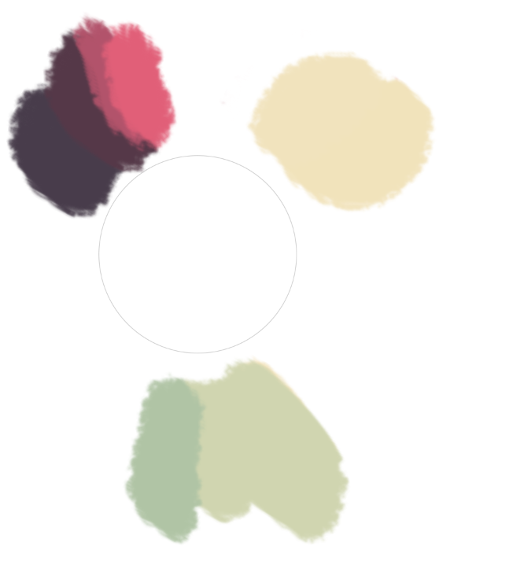
Triadic

Slide 44

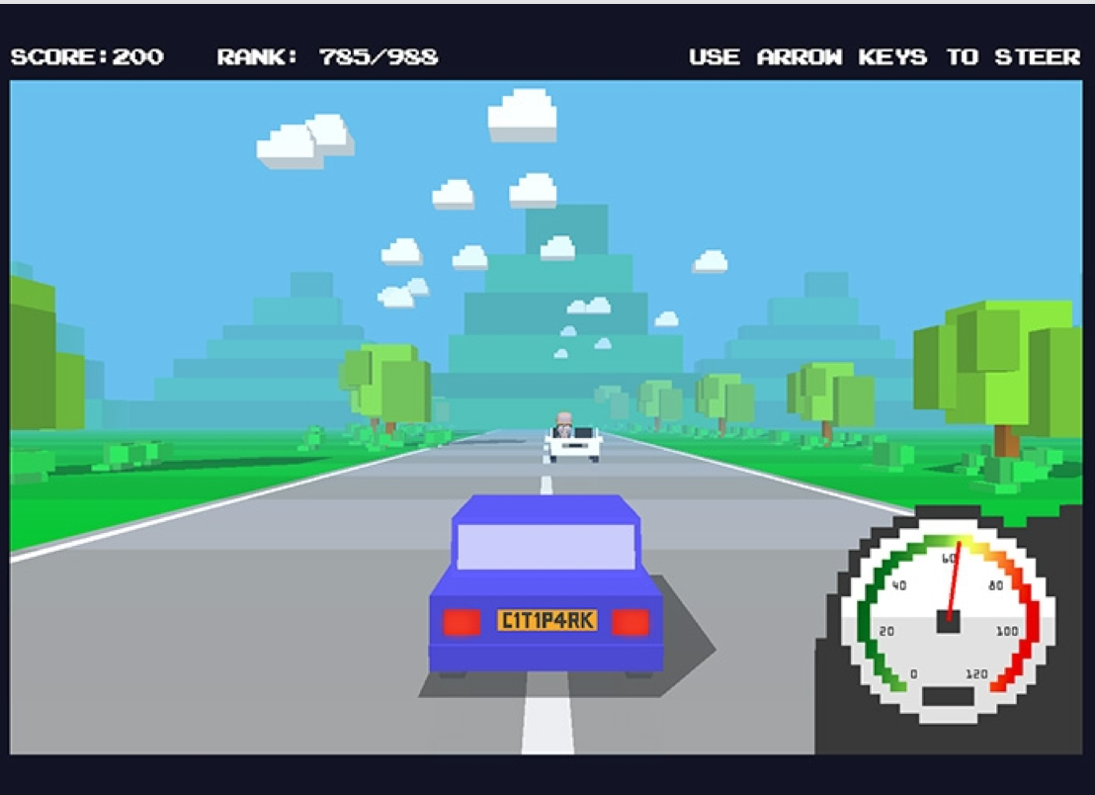
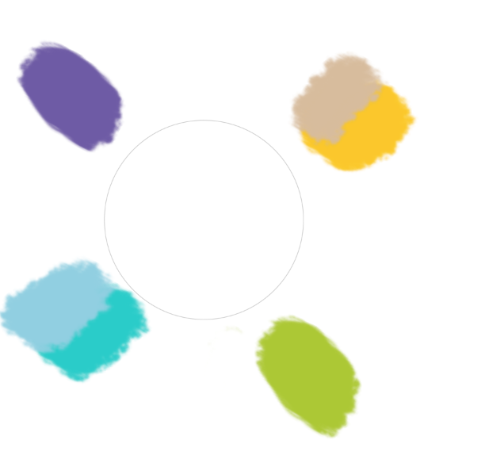
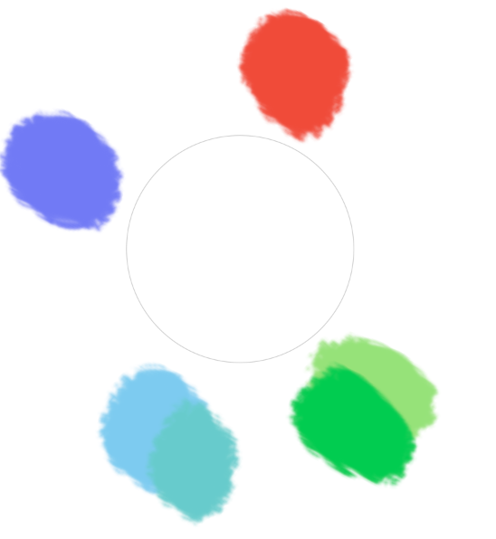
Tertiary

Slide 45
CSS Colors
RGB Hexadecimal
Hexadecimal Digits (base-16)
0, 1, 2, 3, 4, 5, 6, 7, 8, 9, a, b, c, d, e, f (0=0 and f=255)
2 digits for each color channel
#33aaff (51 red; 170 green; 255 blue)
Shorthand: #3af is the same as #33aaff
rgba(255, 255, 255, 0.5)
allows transparency
Named colors
hotpink, aqua, black, blue, fuchsia, gray, green, lime, maroon, navy, olive, purple, red, silver, teal, white, yellow, etc.

Slide 46
Resources: Color Palette Resources
Kuler
Colour Lovers
Coolors.co
ColorBrewer.org
Palette from image

Slide 47
Texture Resources
https://www.transparenttextures.com/
Using textures: some guidelines
Websites that use textures

Slide 48
Outline
Principles of composition
Color
Fonts and Typography
Branding

Slide 49
Typography
Font families
Hierarchy
Body Copy
Conventions
Pairing fonts
Notes:
Part of the way we achieve hierarchy is with typography, As you’re choosing type, be aware of where you want people to look
Conventions based on tradition, how people read, what’s comfortable and accessible.

Slide 50
Font Dimensions
ascent
Montserrat
mean line
x-height
baseline
descent
1 point = 1/72 vertical inch
12 point font = 1/6 vertical inch
Notes:
Characters in the Latin alphabet sit on a common baseline.
Some characters have descenders that dip below the baseline
Others have ascenders that go above the typical mean line.
Font size is typically determined by the space between the descenders and ascenders.
Font size is denoted in points
a point is 1/72 inch, so a 12-point font occupies 1/6 of an inch vertically

Slide 51
Common Fonts
Diagonal
stress
Slanted serifs on
lowercase letters
Oldstyle
Moderate thin/thick
transitions in the strokes
Examples:
Times New Roman, Caslon, Garamond, Palatino, Bembo
Notes:
Let’s talk through a couple common types of fonts
One of the most common types of font is “oldstyle”
These types of fonts were developed very early, starting in the 15th century
Have slanted serifs on lowercase letters
Transitions in the stroke – some parts of the letters are thicker than others
Diagonal stress on the letters
Some common examples include:
Times New Roman
Caslon c 1725
Garamond c 1540
Palatino
Bembo c 1495

Slide 52
Common Fonts
Vertical
stress
Thin horizontal serifs on
lowercase letters
Modern
Radical thin/thick
transitions in the strokes
Examples:
Didot, Bodoni
Notes:
Fonts in the “modern” family grew out of technical advances of the 18th century
Vertical stress instead of horizontal
Thin serifs that are flat
Very strong transitions between the strokes
Examples: Didot, Bodoni

Slide 53
Common Fonts
Thick horizontal serifs on
lowercase letters
Vertical
stress
Slab Serif
Very little thick/thin
contrast in the strokes
Examples:
Rockwell, Memphis
Notes:
Slab serif fonts became popular in the 19th century
Thick horizontal serifs
Vertical stress
Very little contrast in the strokes
Examples: Rockwell, Memphis

Slide 54
Common Fonts
No serifs anywhere
Sans Serif
No thick/thin contrast
in the strokes
Examples:
Helvetica, Arial, Franklin Gothic, Avenir
Notes:
Finally sans serif fonts were developed in the late 19th century to mid-20th century
No serifs, no stress in the stroke, very simple and clean
Examples:
Helvetica
Arial
Franklin Gothic
Avenir (from the iPod homework)

Slide 55
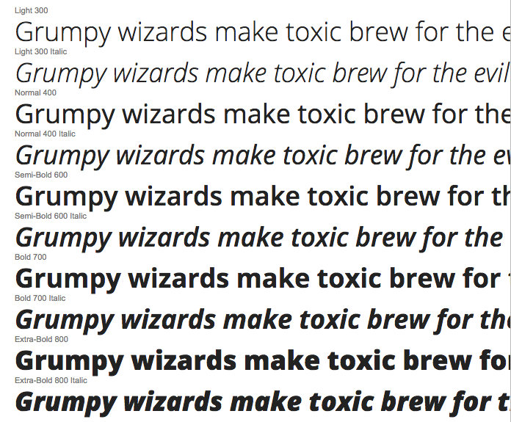
Choosing Body Copy
Ideally choose a type designed for body (Georgia, Arial)
Has italic, bold-italic, and bold
Readable at 14-24 px… Check on your screen!
Open Sans has 10 variations
Source: Ricky Holtz & Ellen Van Wyk
Notes:
Don’t go crazy with fonts on body copy because you want to make reading high volumes easy and comfortable for people
Build hierarchy with different styles
Heard different things about proper font size. Bottom line is, you should check what it actually looks like. Esp because screens are smaller than print, and every font has a different size
Serifs are o-k !

Slide 56

Choosing a title font
Source: Ricky Holtz & Ellen Van Wyk

Slide 57
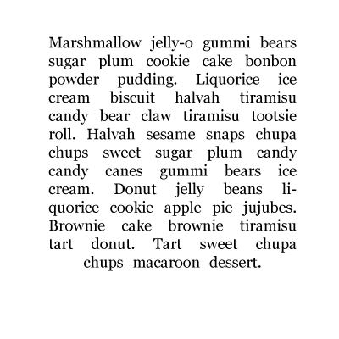
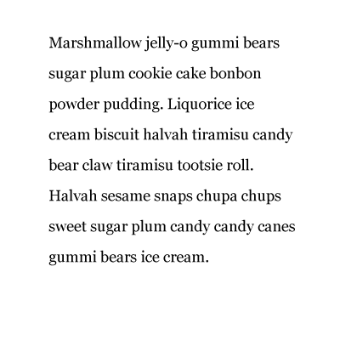
Type Setting
Ideally 50-60,75 characters/line
Avoid rivers
Mind line spacing and word spacing
Source: Ricky Holtz & Ellen Van Wyk
Notes:
If it’s too long, they get lost, if it’s too short, their eyes move around
Ines of white- Avoid. Make sure the text is grey
http://baymard.com/blog/line-length-readability

Slide 58
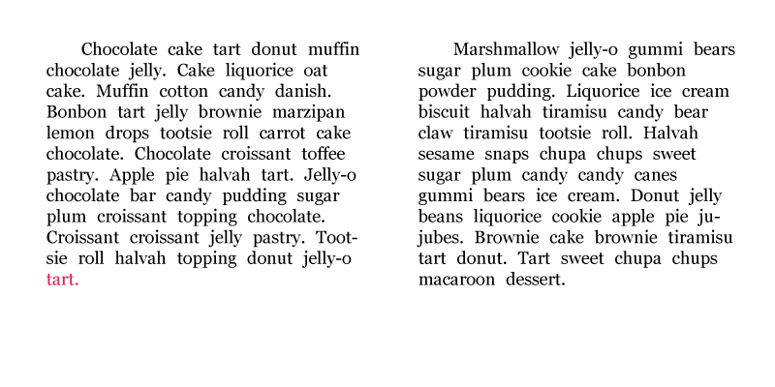
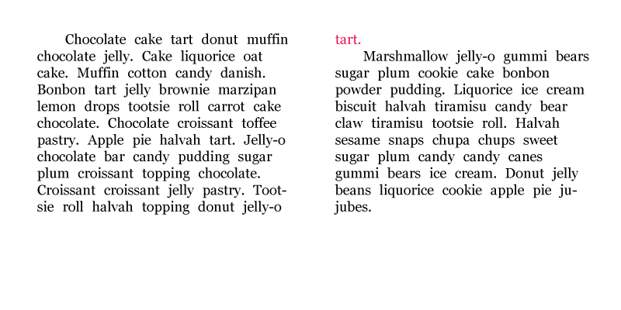
Other Conventions
Use smart quotes: “” not dumb quotes: ""
Avoid orphans and widows
Orphan
Widow
Source: Ricky Holtz & Ellen Van Wyk
Notes:
http://baymard.com/blog/line-length-readability

Slide 59
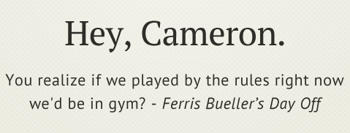
Pairing Fonts: Contrast
Weight
Size
Style
Family
PT Sans and PT Serif. Same family, different style
Source: Ricky Holtz & Ellen Van Wyk
Notes:
I’m not an expert at this but there are some rules and starting points.
Have enough similarities and differences that they belong and serve different purposes

Slide 60
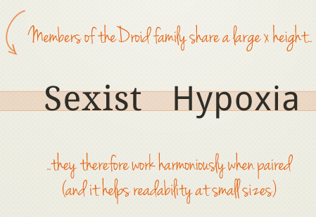
Pairing Fonts: Concordance
Look at the x height
Source: Ricky Holtz & Ellen Van Wyk

Slide 61
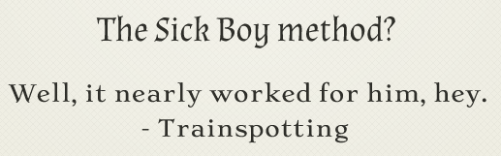
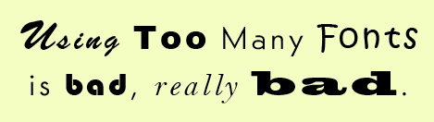
How to not pair fonts: Conflict
Too similar
Similar and different in the wrong ways
Different x height, similar serifs. What purpose is each serving?
Too many
Source: Ricky Holtz & Ellen Van Wyk
Notes:
Some people think italic is a separate font… So the point is, be cautious when adding new fonts. Safe to have a display font and body copy.

Slide 62
Font Selection Guidelines
Aim for simplicity and contrast
Don't use more than 2 or 3 fonts
One for body text, one for titles and headings
Use font features to create contrast
Size, color, weight (e.g. bold), style (e.g. caps)
No more than 3-4 font varieties
Don’t mix fonts that serve a similar purpose
Don’t use two different serif fonts for body copy
Notes:
Aim for simple font choices in most cases, but also use fonts to create important contrasts
Don’t use more than 2 or 3 different fonts
Maybe a serif for body text, and sans-serif for titles and headings
Then use features of the fonts to create additional contrast
Within a single font you can vary the size, color, weight, and stlye
In general, 4 or 5 different varieties should be enough!
Also, it’s not a good idea to mix fonts that serve a similar purpose
There’s no point in using two different serif fonts for the main text in two places
Be consistent and intentional in your font choices!

Slide 63
Font Spacing Guidelines
Be generous with whitespace
Always leave margins around body text
Never pack it tightly against an edge
Use generous line height (but not too far away)
Make sure body text is not crowded
CSS: line-height: 120% or more
Keep text paragraphs narrow
About 60 - 75 characters / 12 - 15 words
Generally easier to read.
Notes:
Here are some guidelines for spacing in your body text, so paragraphs of text.
Be generous with whitespace
Always leave margins around body text
Never pack it tightly against an edge
Use generous leading
Make sure body text is not crowded
CSS: line-height: 120% or more (20/24)
Keep text paragraphs narrow
About 60 - 75 characters / 12 - 15 words
Generally easier to read.

Slide 64
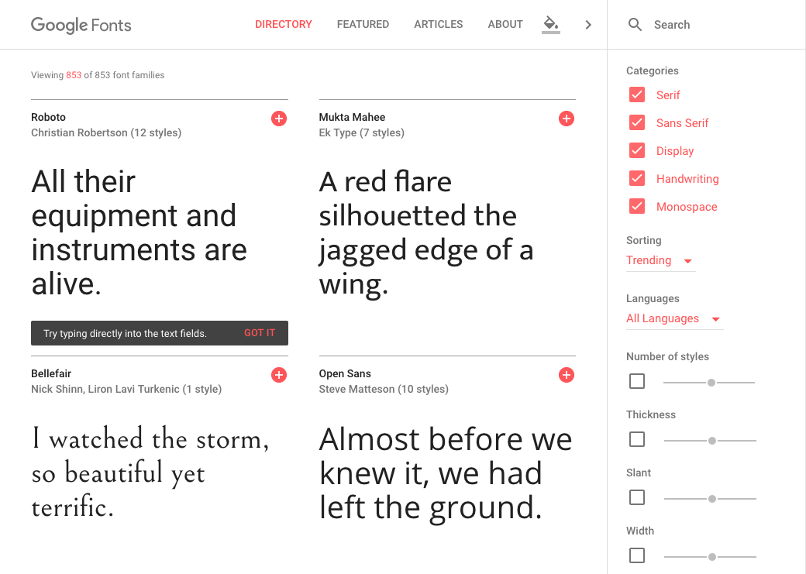
Resources: Google Fonts
https://fonts.google.com/
Notes:
Google has an outstanding fonts library
You can browse fonts and get the code to embed them into your webpage

Slide 65
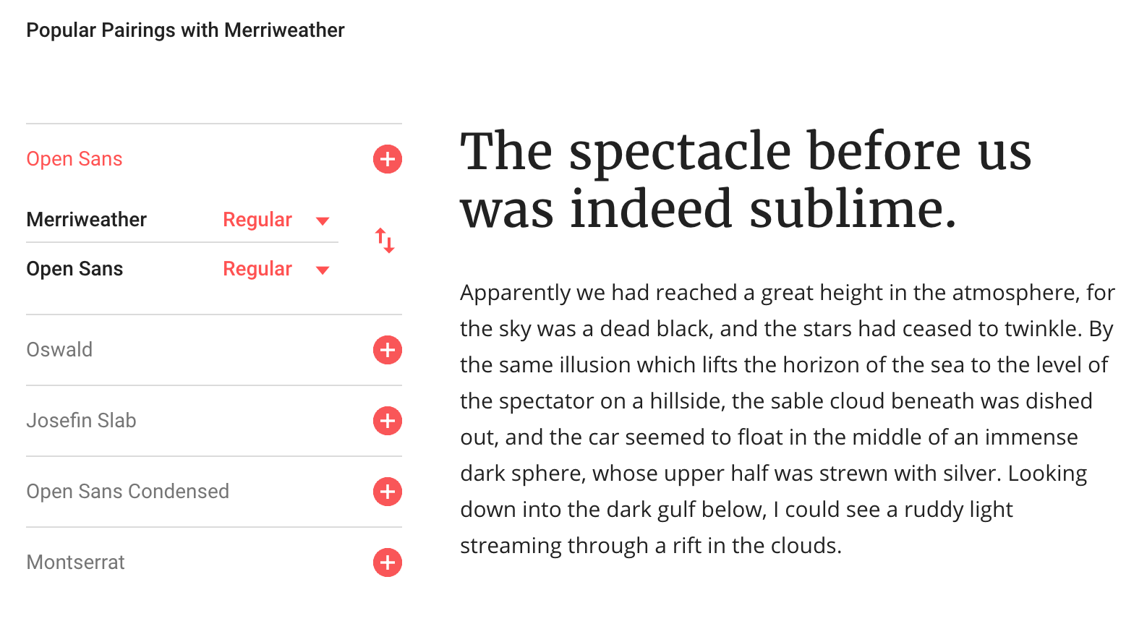
Resources: Google Font Pairings
Notes:
When you select a font through Google Fonts, you can browse fonts that pair well with the one you selected.

Slide 66
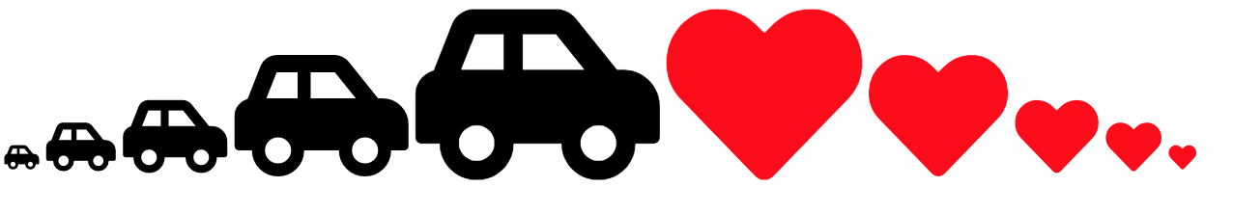
Resources: Font Awesome Icons
https://codepen.io/vanwars/pen/wZyPLB?editors=1000
Enables icons to have font properties (so that you can color them and scale them easily)

Slide 67
Outline
Principles of composition
Color
Fonts and Typography
Branding

Slide 68
Visual design can communicate values
Abundance Acceptance Accountability Achievement Adventure Advocacy Ambition Appreciation Attractiveness Authenticity Autonomy Balance Being the Best Benevolence Boldness Brilliance Calmness Caring Challenge | Daring Decisiveness Dedication Dependability Diversity Empathy Encouragement Enthusiasm Ethics Excellence Expressiveness Fairness Family Friendships Flexibility Freedom Fun Generosity Grace | Kindness Knowledge Leadership Learning Love Loyalty Making a Difference Mindfulness Motivation Optimism Open-Mindedness Originality Passion Performance Personal Development Proactive Professionalism Quality | Professionalism Punctuality Relationships Reliability Resilience Resourcefulness Responsibility Responsiveness Security Self-Control Selflessness Simplicity Stability Success Teamwork Thankfulness Thoughtfulness Traditionalism Trustworthiness

Slide 69


Slide 70
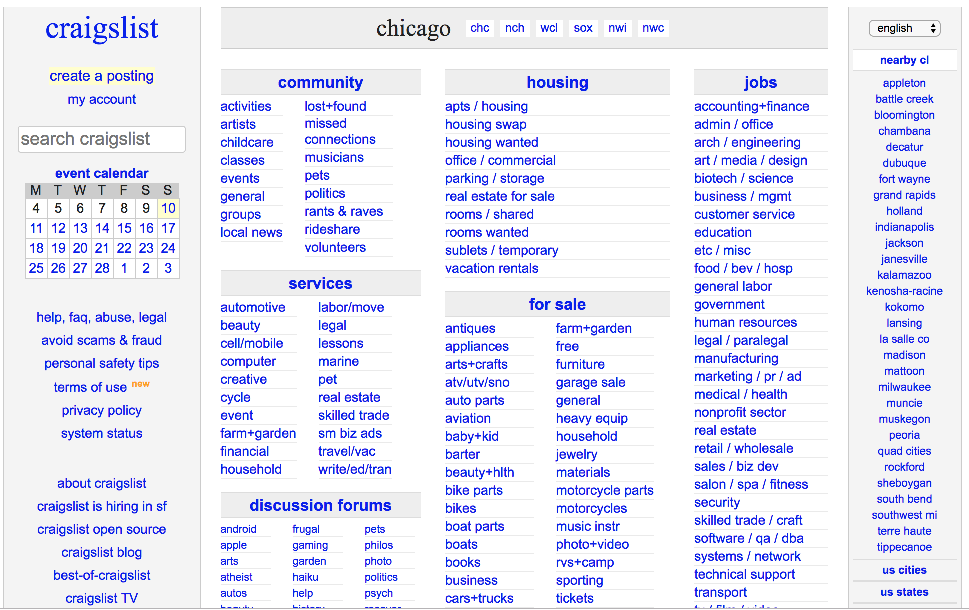

Slide 71
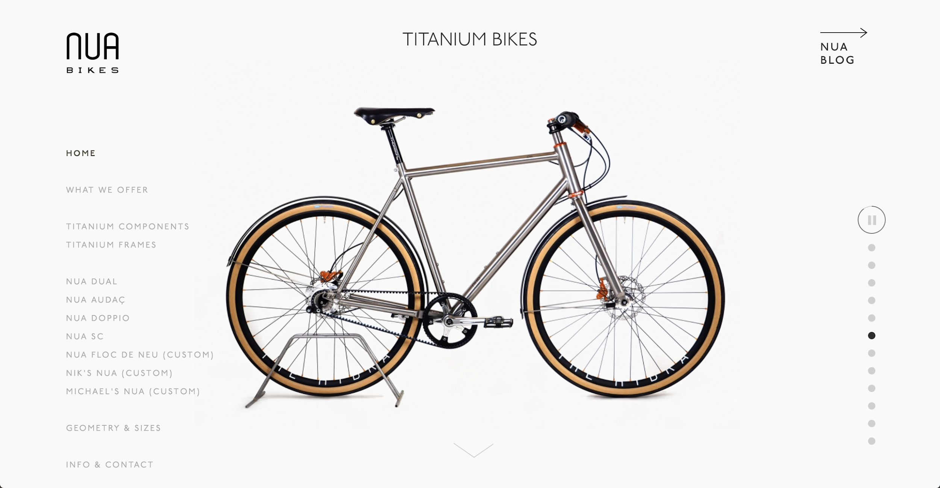
Notes:
What are the values of this website?

Slide 72


Slide 73


Slide 74
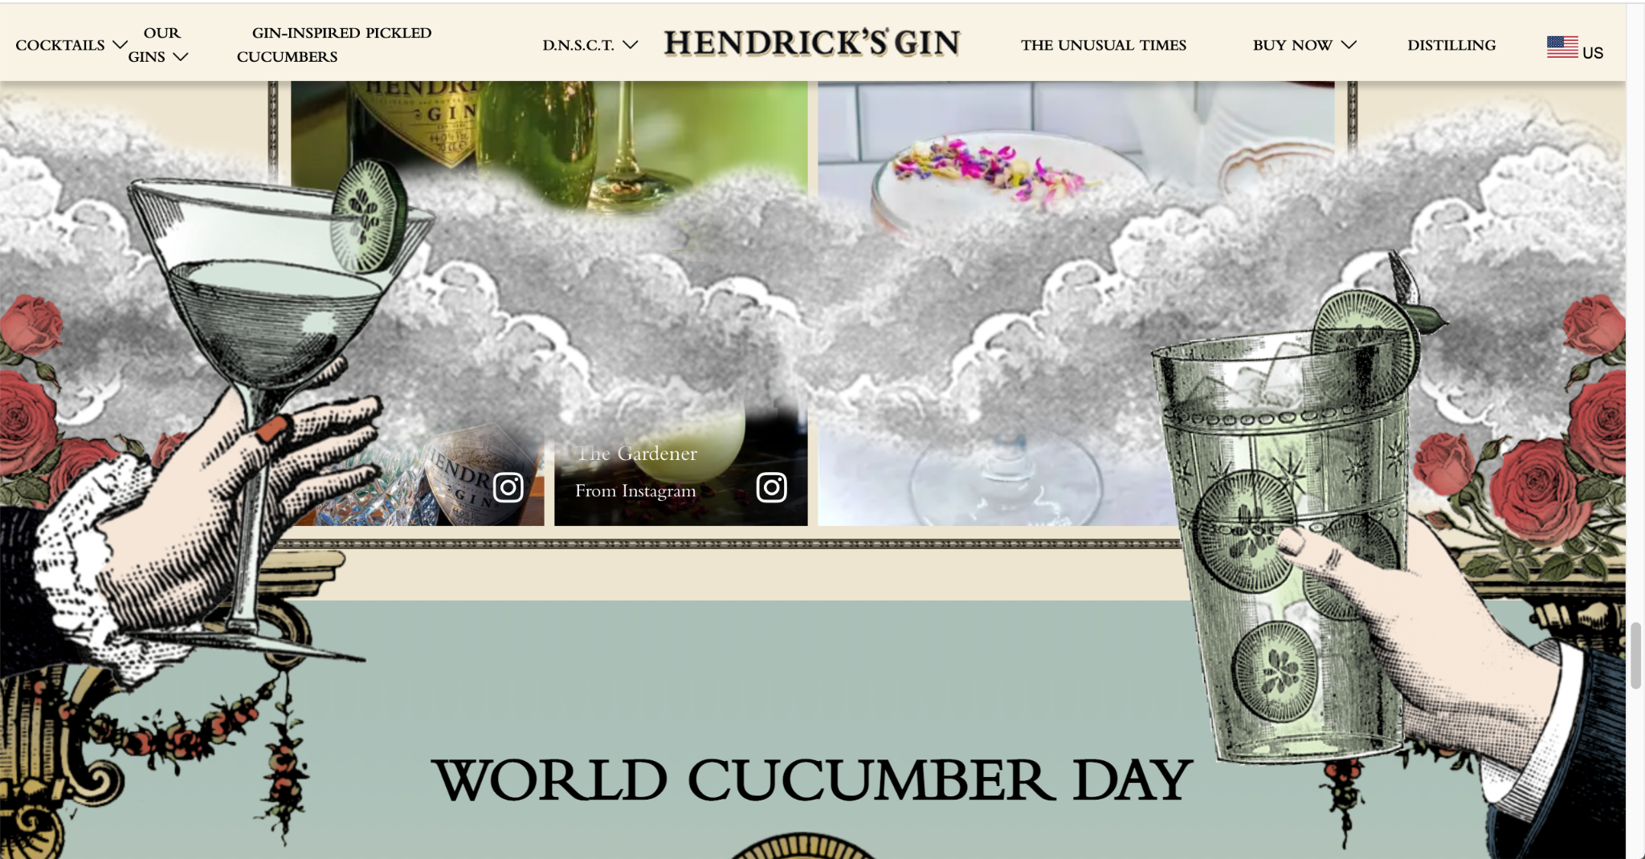

Slide 75
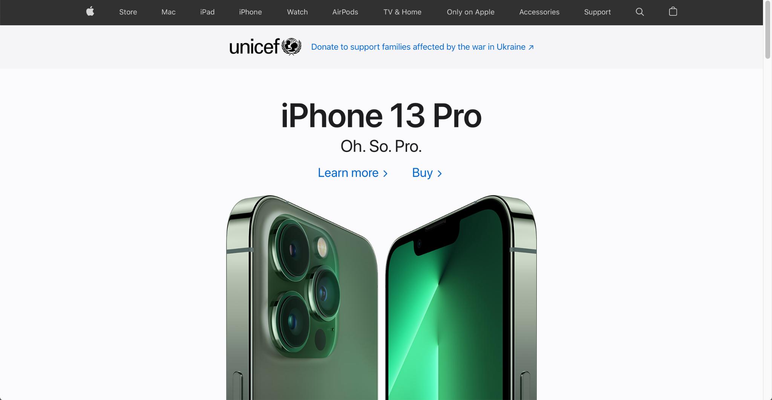

Slide 76
Building a Brand Identity

Slide 77
Branding Kits
Selecting core values
Figuring out your primary mission
What is foreground?
What is background?
Figuring out a look-and-feel that communicates your values
How will you make use of colors, fonts, images, effects, etc. to instantiate your brand?

Slide 78
Branding Kits
Many websites / apps / platforms publish their branding kits:
Spotify
Northwestern
As you instantiate your frameworks, keep in mind that most companies have standardized widgets, stylesheets, and guidelines to ensure an integrated look-an-feel. Use them to get ideas.

Slide 79
Sample Style Guides
Salesforce’s Lightning Design System
Alibaba’s Ant Design
Atlassian’s Design Guidelines
Firefox’s Photon Design
IBM’s Carbon Design
Intuit’s Harmony Design
Shopify’s Polaris

Slide 80
For your final project...
Think about how you might visually instantiate a brand identity for your own personal website / online portfolio?

